Slide 1
Our Fractal World
By Divy Bramhecha s1885517

Slide 2
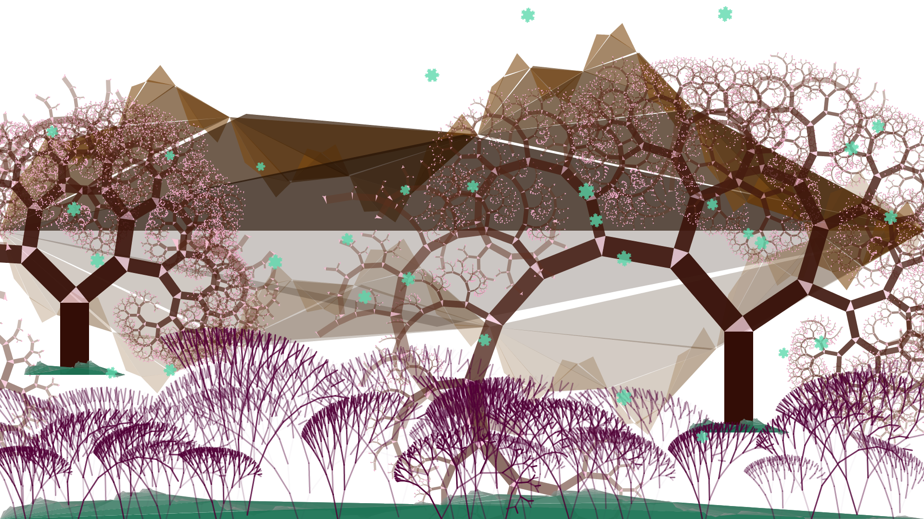
A world created entirely of Recursive Fractals.

Slide 3
Created using, L-systems for the violet flowers
Pythagorean fractal for the two trees.
The mountain / landscapes are my own fractals.
They were made by taking a line, taking a mid point (code modified for roughly around mid point [random]) and moving the point up or down.
Doing that creates two new lines, which then undergo the same process.
Snowflakes, created based on Koch Snowflake pattern.
I’ll demonstrate the process of creating the picture you saw in the previous slide.

Slide 4
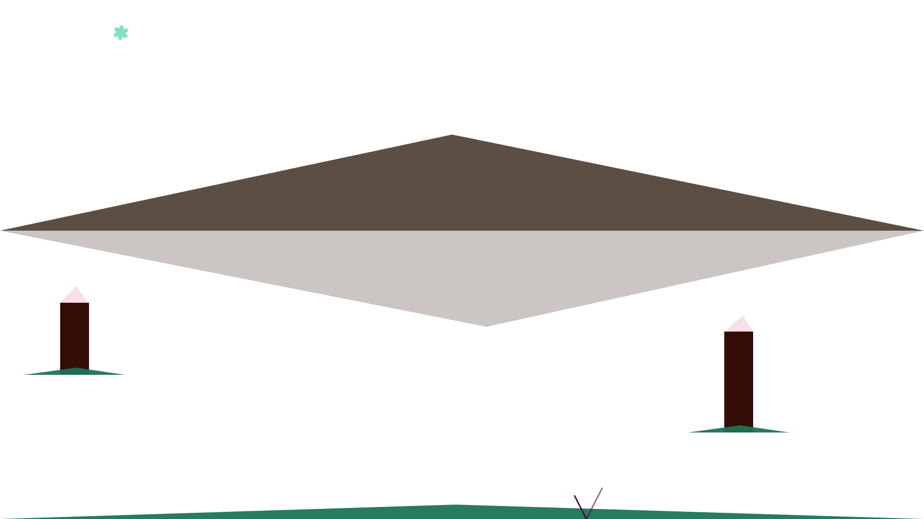
1st Iteration
These are the results when you iterate these fractals for one time. This consists of the 4 landscapes (the mountain and its reflection, 3 greenish blue land body.) The brown stumps are the origin for Pythagorean trees. The purple / lilac V is the stem of L-system based flowers. The blue snowflake is a Koch snowflake.

Slide 5
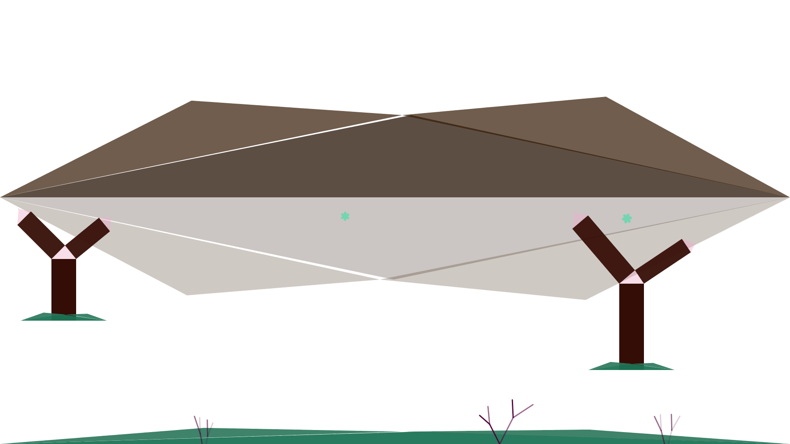
2nd Iteration
This is the second iteration. Note, how the plants on the bottom have become 3 from 1, this is because they are like seeds being sowed in the earth on a line with each half of the line consisting of no plants. (roughly half, a random function with a deviating from the middle)

Slide 6
All the fractals used.
I’ll demonstrate how every fractal used looked like, and some of the results of my experiments.

Slide 7
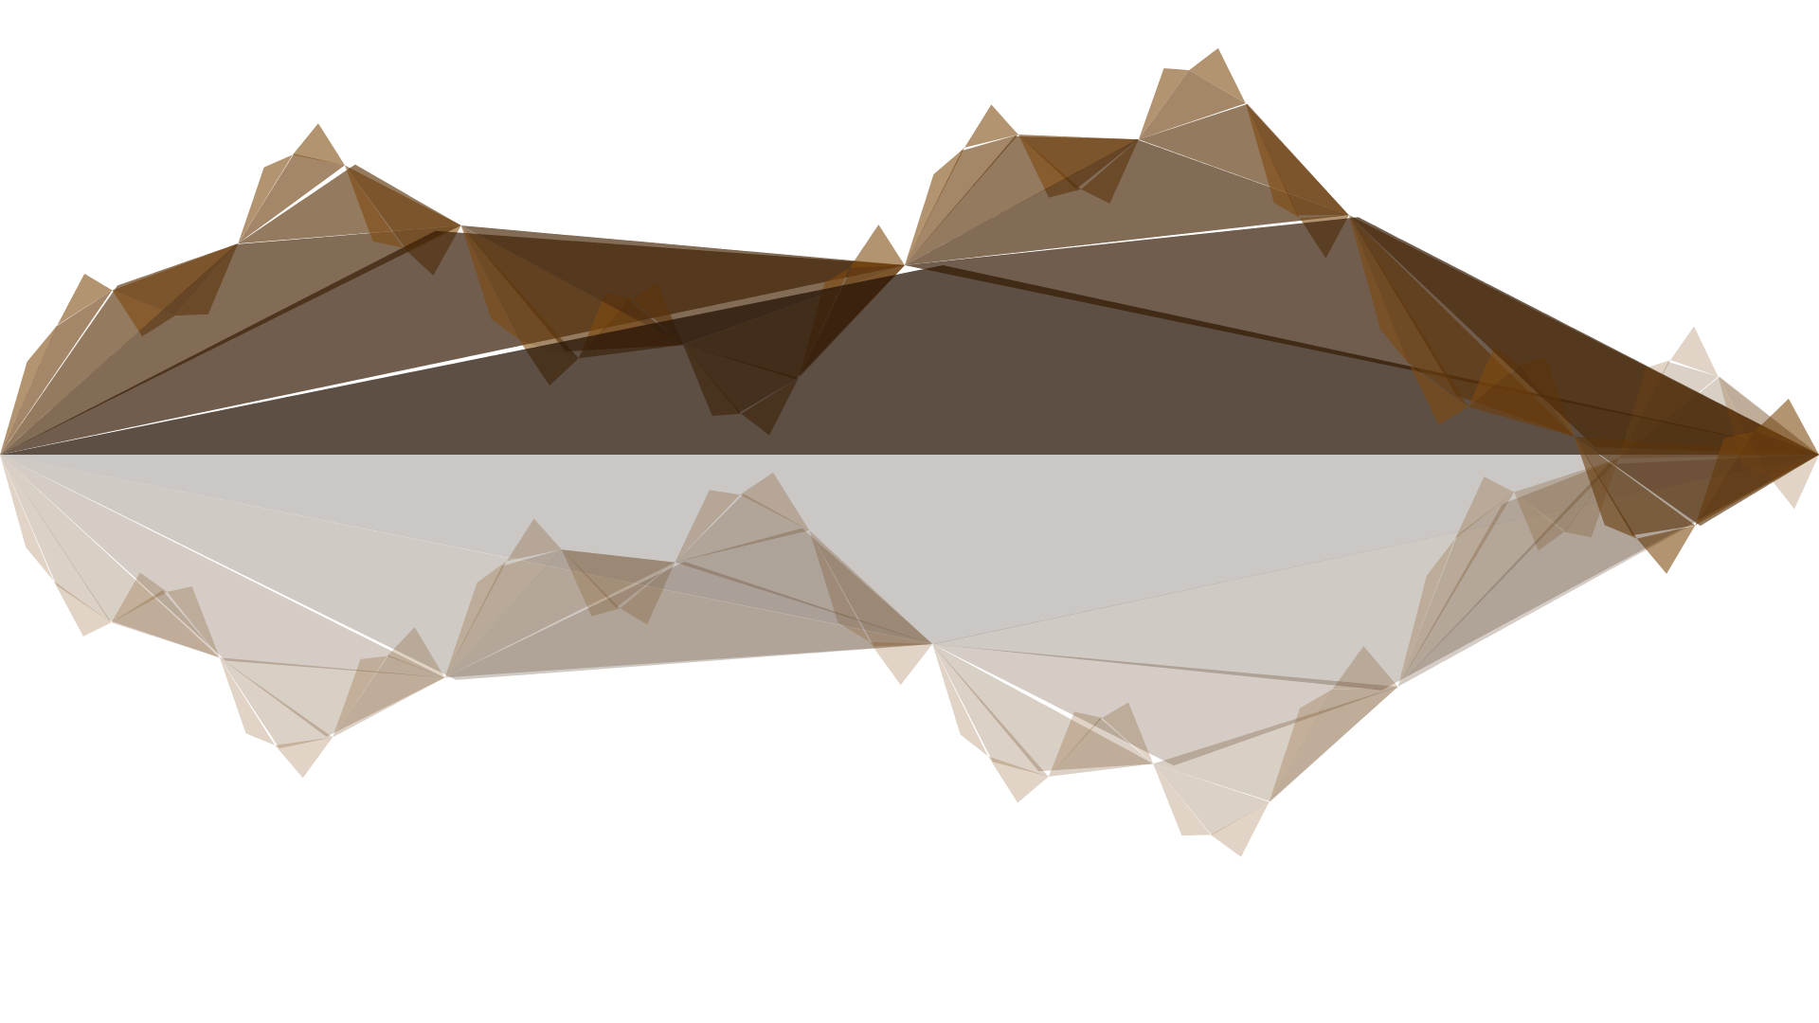
The Mountains

Slide 8
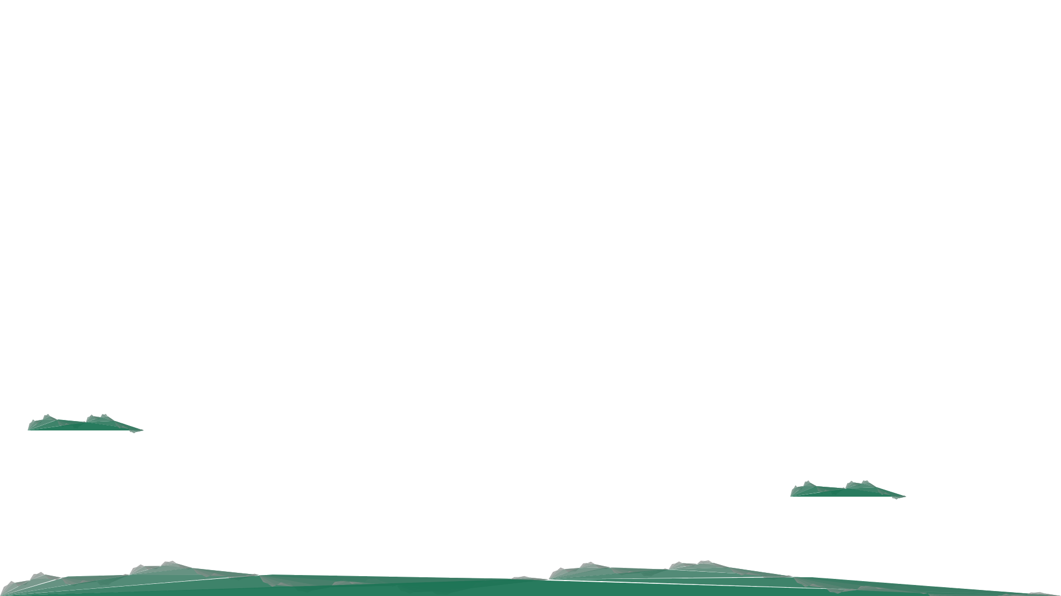
The other land bodies.

Slide 9
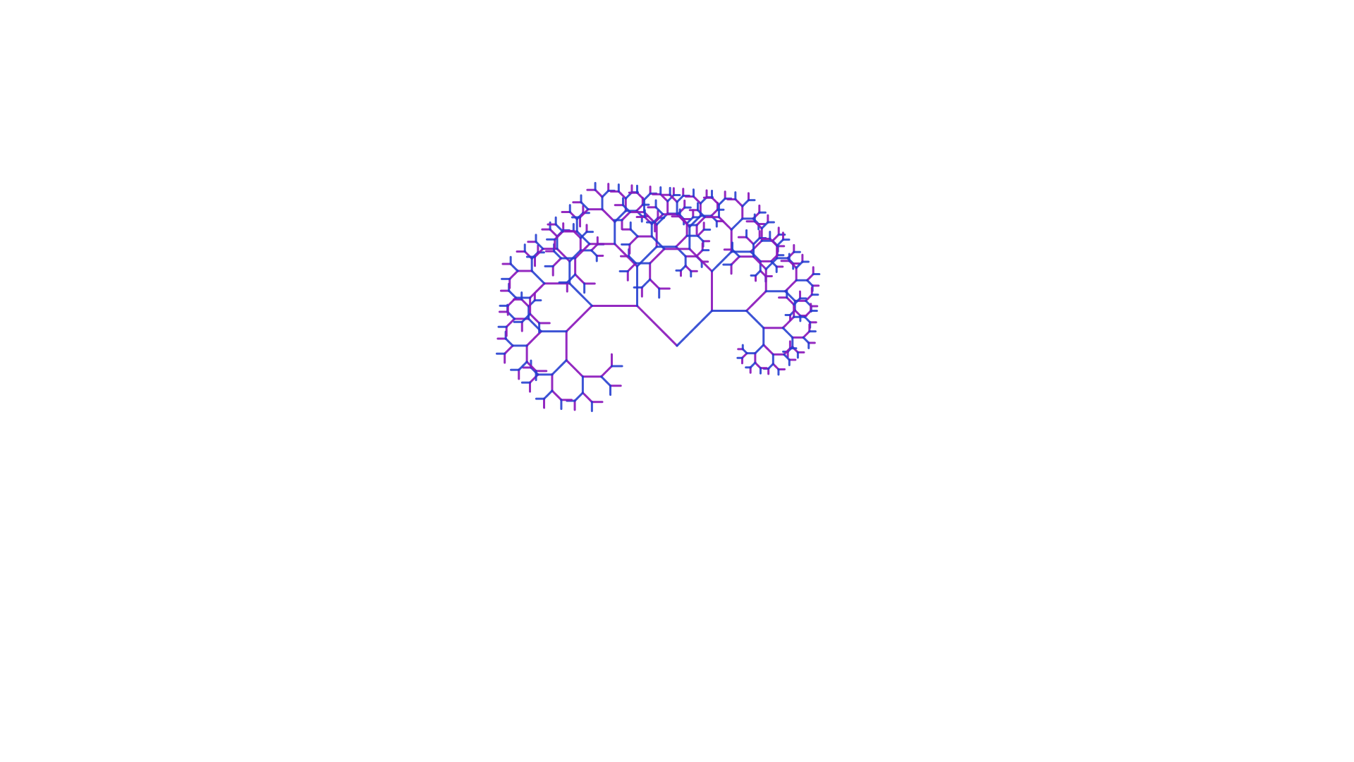
L-System Based Flower/Tree

Slide 10
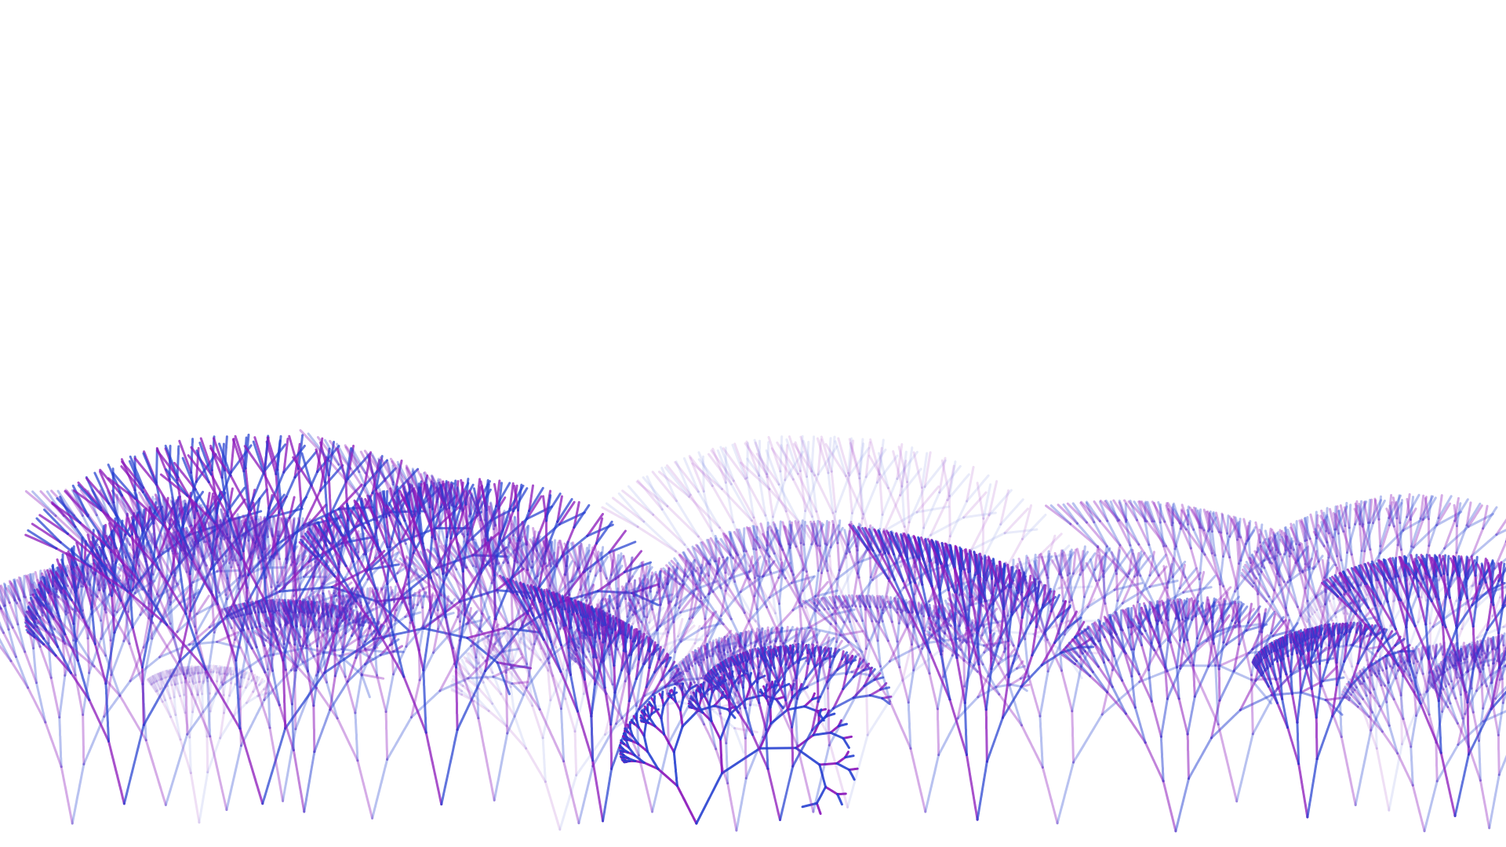
L-System based Flowers/plants

Slide 11
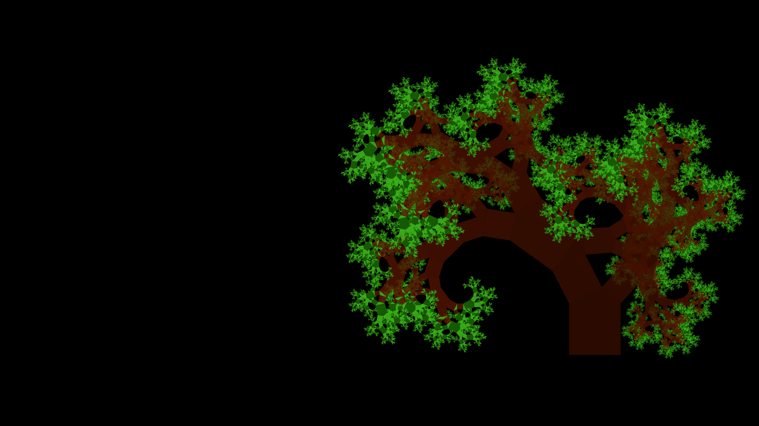
Pythagorean Tree

Slide 12
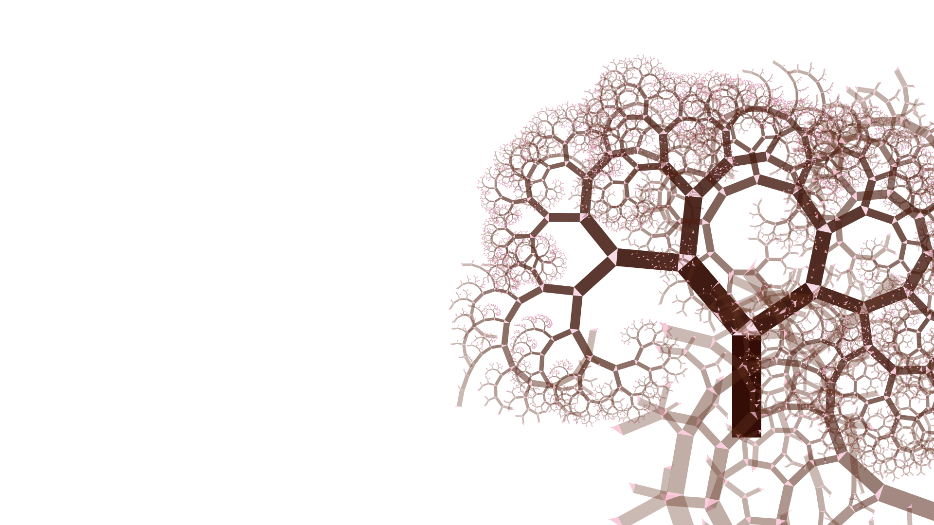
Pythagorean Tree

Slide 13
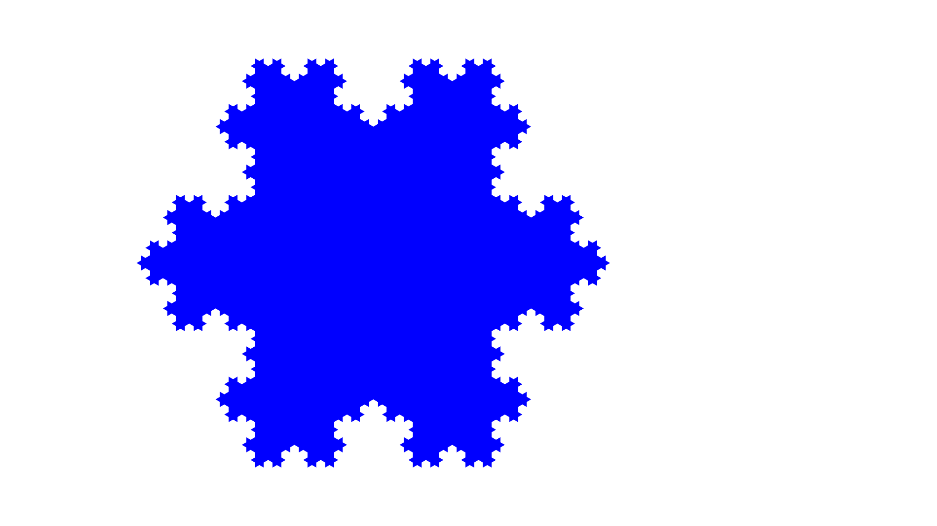
Koch Snowflake

Slide 14
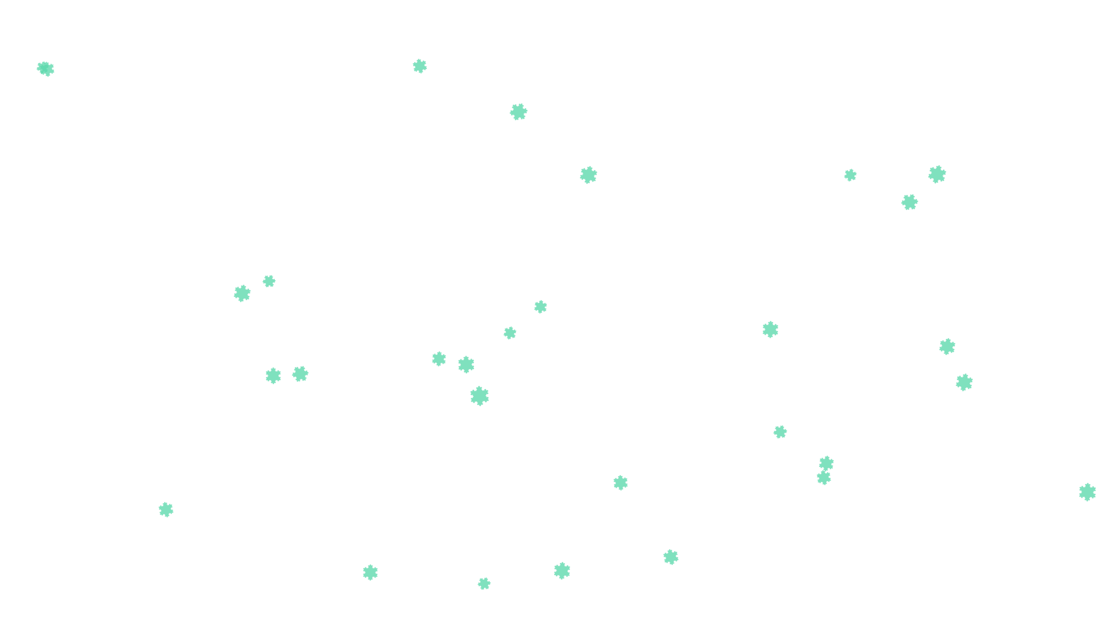
Koch Snowflakes

Slide 15
Guidelines for understanding the code
All these fractals are isolated into their own files.
I created a module called GraphicsHelperFunctions in which I have defined functions which were useful in creating the fractals.
Please note, the file called GraphicsM.hs is not made by me, I have referenced it later.
All these fractals output are brought together in file called “fractals” which needs to be used to generate the image on the first slide.
Thank you.

Slide 16
References
https://www.youtube.com/watch?v=9dk7_GDNocQ&t=448s A conference talk by M.M.T Chakravarty.
I have used the graphics packages used by the person mentioned above. I followed YouTube link to his GitHub page.
https://github.com/mchakravarty/HaskellSpriteKit (The library is too vast for me to understand, but I just installed the package called GraphicsM)
Other libraries used include, Rasterfic, Codec.Picture, and Juicy Pixels.

